Slide 1
Rischio di Carcinoma Esofago-Gastrico dopo OAGB
PD Dr. med. habil. Sonja Chiappetta
Head of the Department of General and Laparoscopic Surgery
Center of Excellence Bariatric and Metabolic Surgery
Ospedale Evangelico Betania, Naples, Italy

Slide 2
Conflict of interest disclosure (COI)
I have the following potential conflict of interest to report
Receipt of honoraria or consultation fees:
Johnson & Johnson America (2021, 2024)
Novo Nordisc (2021)
Genesis Medtech (USA) (2023)

Slide 3
Case mix disclosure

Slide 4
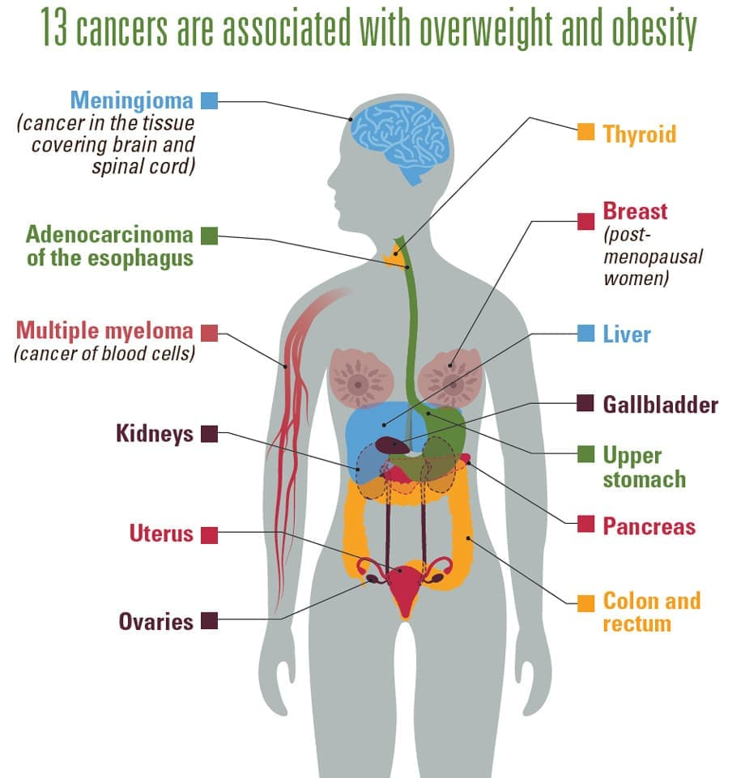
Correlation between Cancer and Obesity
Obesity is a significant risk factor for developing various types of cancer.
According to the CDC, obesity is associated with about 40 %of cancer cases in the United States.
Cancer incidence has increased in parallel with the obesity epidemic, with a significant increase in oesophageal and stomach cancer cases.

Slide 5
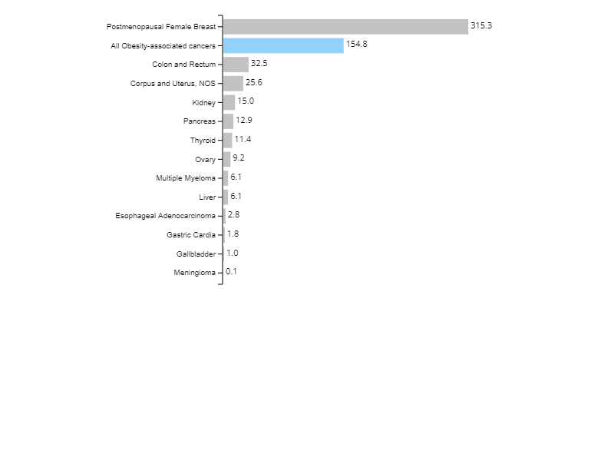
Rate of New Obesity-associated Cancers by Cancer Type
All Obesity-associated Cancers,
Male and Female, United States, 2020
More than 684,000 obesity-associated cancers occur in the United States each year, including more than 210,000 among men and 470,000 among women.
Breast cancer after menopause is the most common obesity-associated cancer among women.
Colorectal cancer is the most common obesity-associated cancer among men.
More than 90% of new obesity-related cancers occur in men and women who are 50 years old or older. More than 684,000 obesity-associated cancers occur in the United States each year, including more than 210,000 among men and 470,000 among women.
Rate per 100,000 people
Source - U.S. Cancer Statistics Working Group. U.S. Cancer Statistics Data Visualizations Tool, based on 2022 submission data (1999-2020): U.S. Department of Health and Human Services, Centers for Disease Control and Prevention and National Cancer Institute; https://www.cdc.gov/cancer/dataviz, released in November 2023.

Slide 6
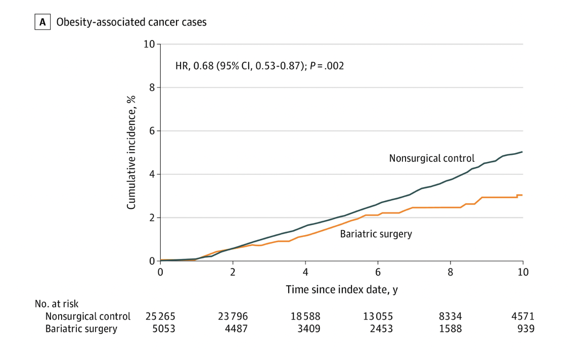
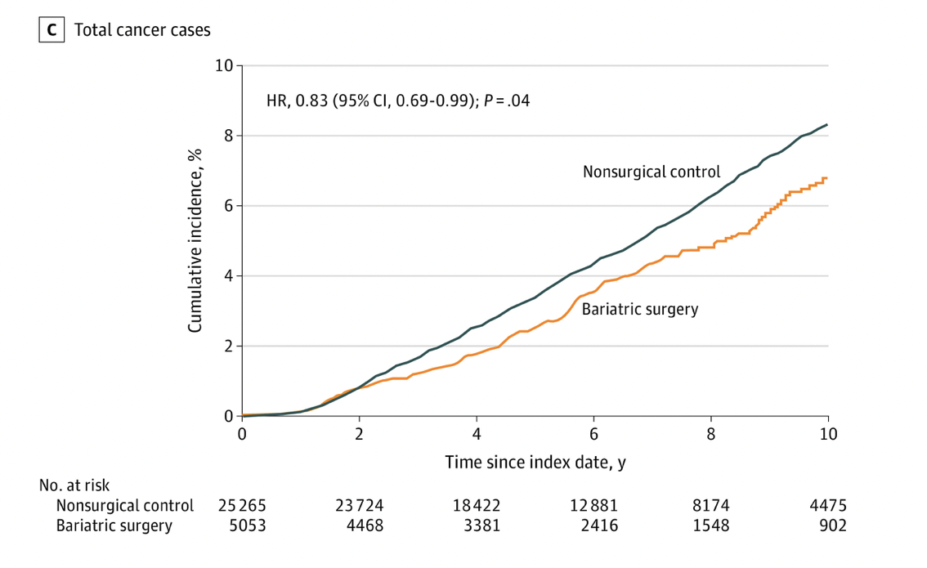
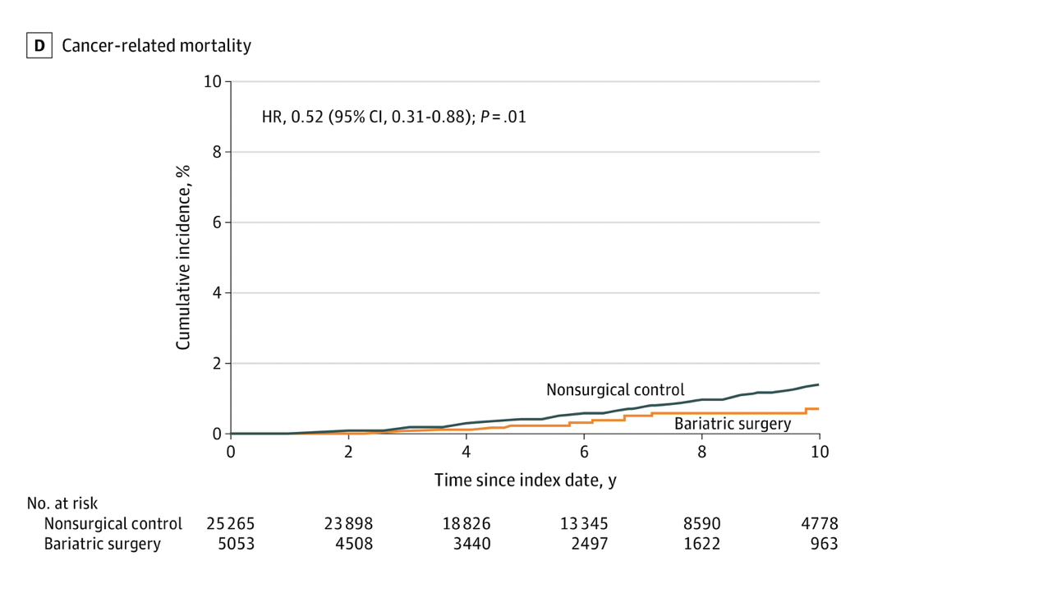
Association of Bariatric Surgery With Cancer Risk and Mortality in Adults With Obesity
Among adults with obesity, bariatric surgery compared with no surgery was associated with a significantly lower incidence of obesity-associated cancer and cancer-related mortality.
Aminian A et al. Association of Bariatric Surgery With Cancer Risk and Mortality in Adults With Obesity.
JAMA. 2022 Jun 28;327(24):2423-2433. doi: 10.1001/jama.2022.9009. PMID: 35657620; PMCID: PMC9166218.
In the SPLENDID (Surgical Procedures and Long-term Effectiveness in Neoplastic Disease Incidence and Death) matched cohort study, adult patients with a BMI of 35 or greater who underwent bariatric surgery at a US health system between 2004 and 2017 were included.
Bariatric surgery (n = 5053), including Roux-en-Y gastric bypass and sleeve gastrectomy, vs nonsurgical care (n = 25 265).

Slide 7
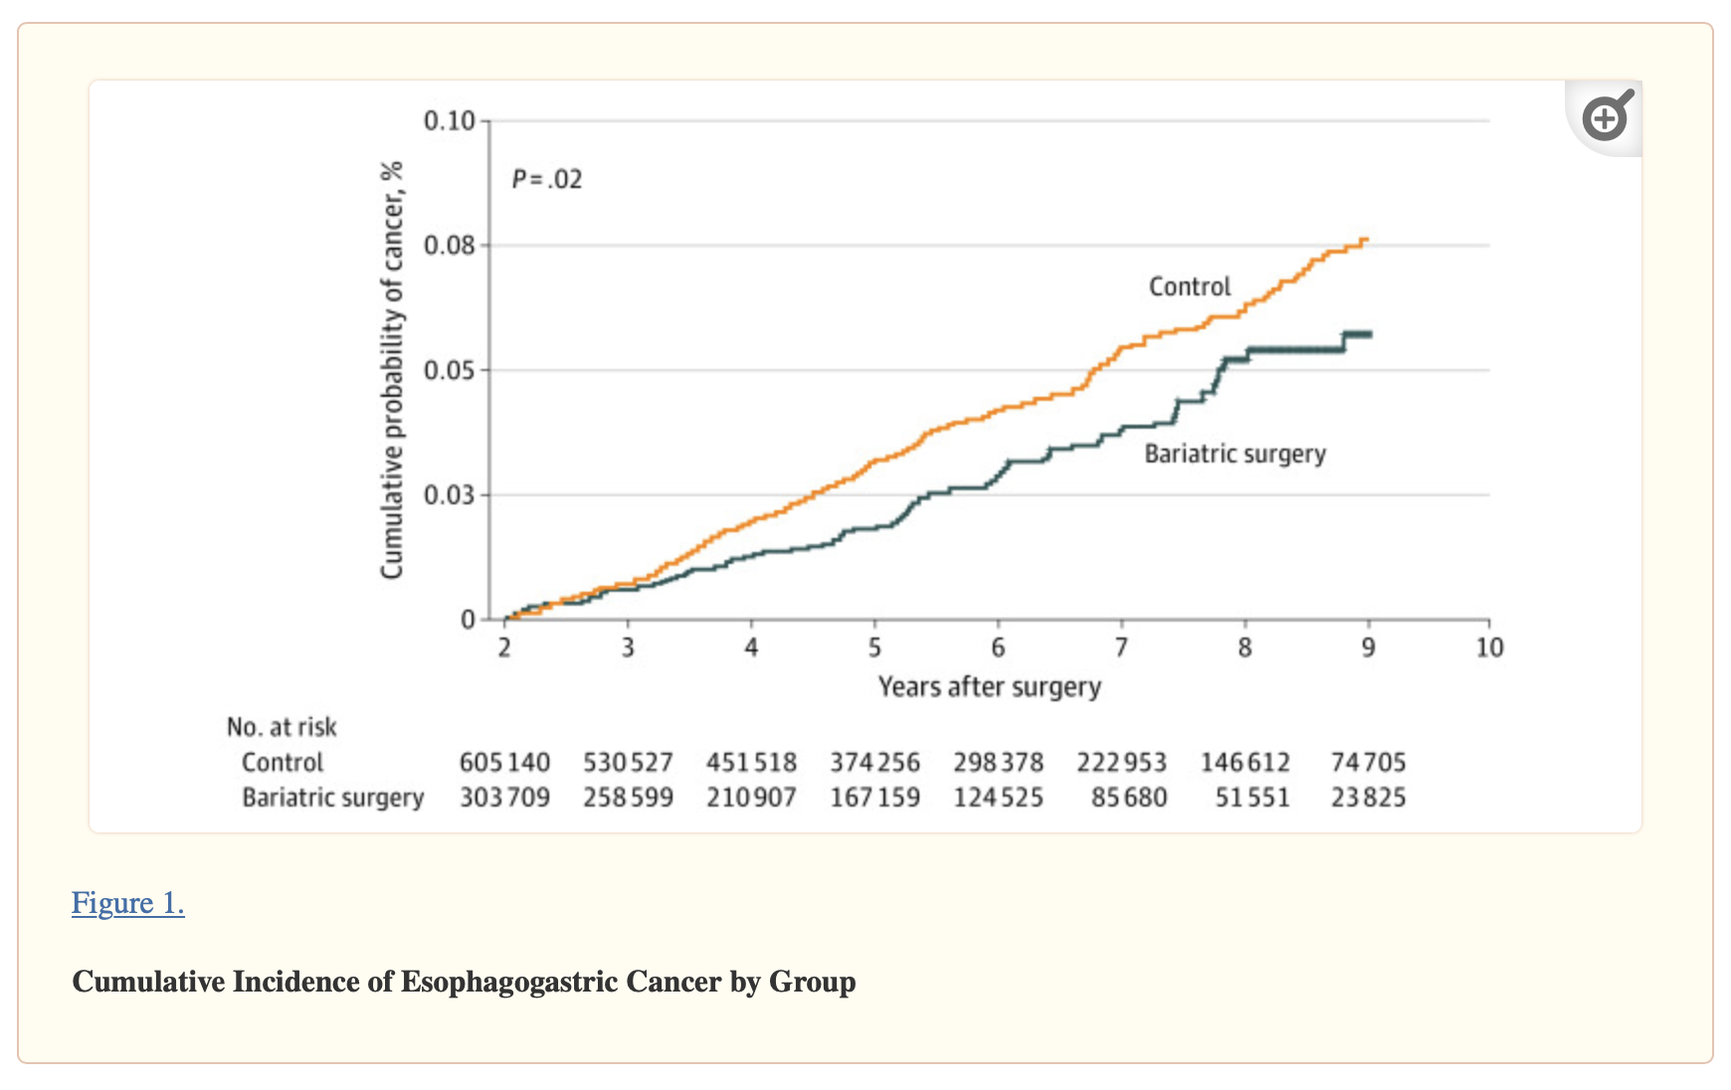
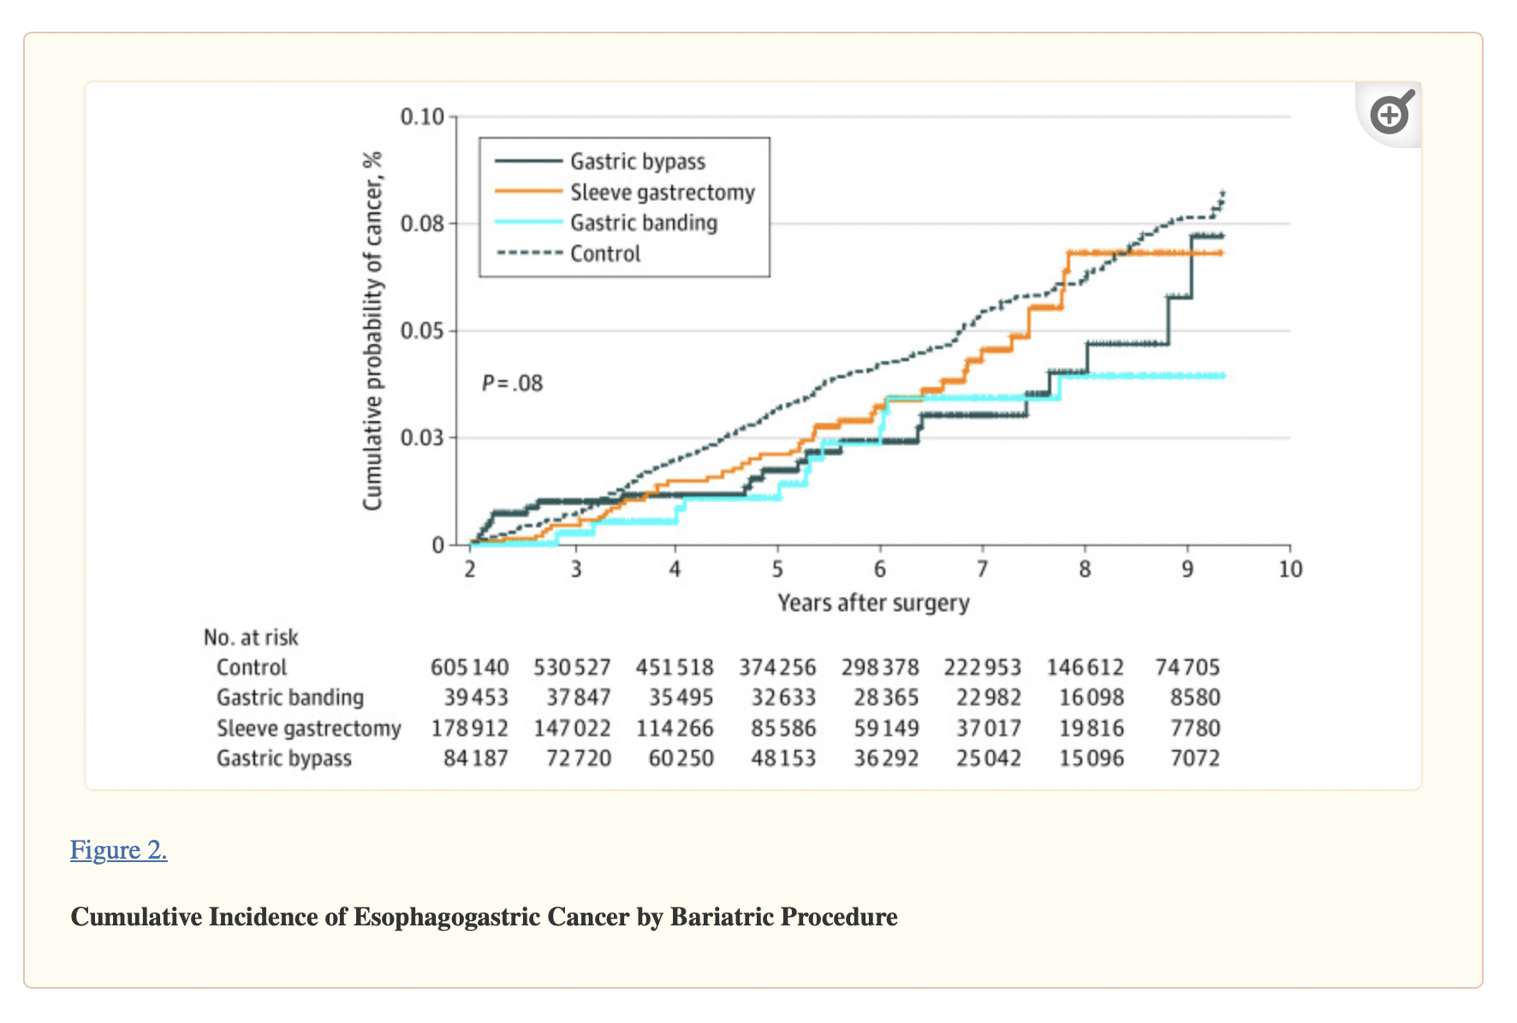
Risk of Esophageal and Gastric Cancer After Bariatric Surgery
In this cohort study of 908 849 patients with severe obesity, bariatric surgery was associated with a significant reduction of esophageal and gastric cancer incidence compared with patients who did not undergo bariatric surgery (6.9 vs 4.9 per 100 000 population per year).
Lazzati A, Poghosyan T, Touati M, Collet D, Gronnier C. Risk of Esophageal and Gastric Cancer After Bariatric Surgery.
JAMA Surg. 2023 Mar 1;158(3):264-271. doi: 10.1001/jamasurg.2022.6998. PMID: 36630108; PMCID: PMC9857712..
This cohort study obtained data from a national discharge database, including all surgical centers, in France from January 1, 2010, to December 31, 2017. Participants included adults (aged ≥18 years) with severe obesity who underwent bariatric surgery (surgical group) or who did not (control group). Baseline characteristics were balanced between groups using nearest neighbor propensity score matching with a 1:2 ratio. The study was conducted from March 1, 2020, to June 30, 2021.

Slide 8
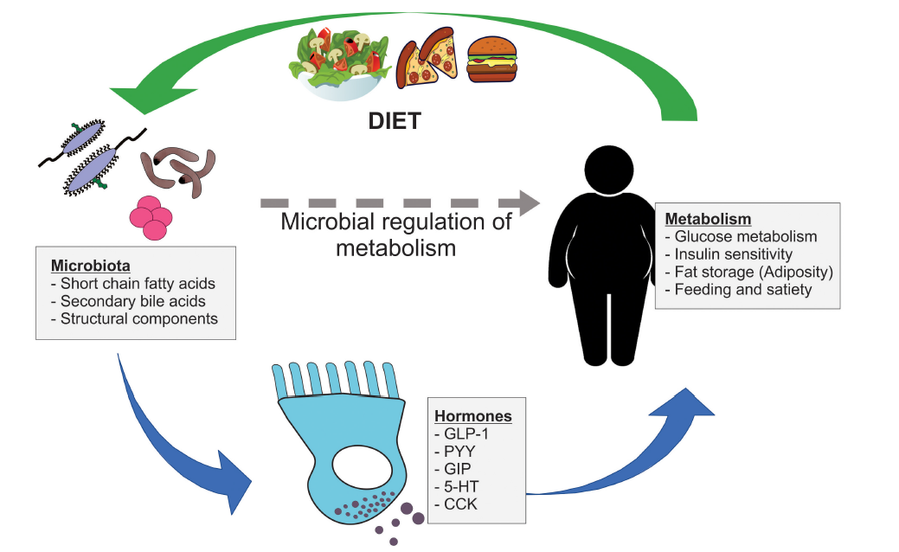
HOW?
Metabolic IMPROVEMENTs
Weight LOSS
Notes:
Weight loss: Reduced adiposity may decrease inflammation and insulin resistance, which are associated with cancer development.
Metabolic improvements: Better glycemic control and lipid profile post-surgery may contribute to reduced cancer risk.
While the reduction in cancer risk after BMS is evident, further research is needed to fully understand the underlying mechanisms. Continued investigation is crucial for optimizing cancer prevention strategies in patients undergoing BMS.

Slide 9
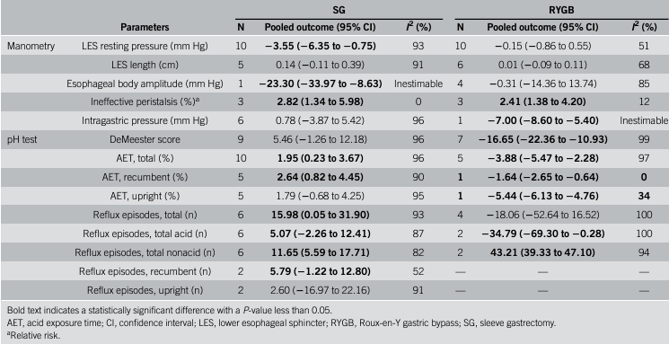
Biological Mechanisms and Cancer after OAGB
Concerns exist regarding bile reflux (BR) gastritis after OAGB, potentially increasing the risk of malignancy, particularly esophageal carcinoma.
Early detection of Barrett's esophagus or carcinoma of the esophagus or stomach is crucial.
Acid, alkaline reflux and hiatal hernia are risk factors
Jaruvongvanich, Veeravich et al. “Esophageal Pathophysiologic Changes and Adenocarcinoma After Bariatric Surgery: A Systematic Review and Meta-Analysis.” Clinical and translational gastroenterology vol. 11,8 (2020): e00225.
Aggarwal, Sandeep et al. “Adenocarcinoma of oesophagus involving gastro-oesophageal junction following mini-gastric bypass/one anastomosis gastric bypass.” Journal of minimal access surgery vol. 16,2 (2020): 175-178.

Slide 10
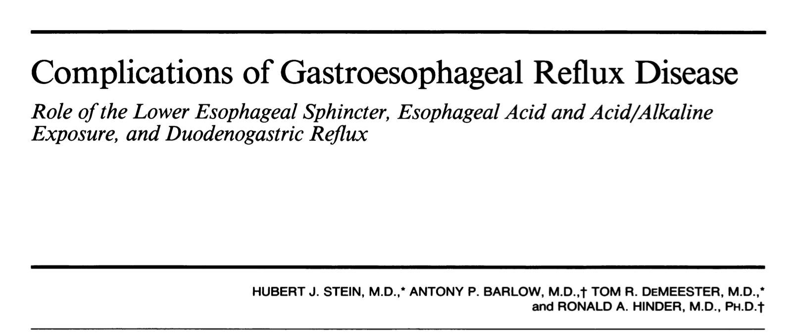
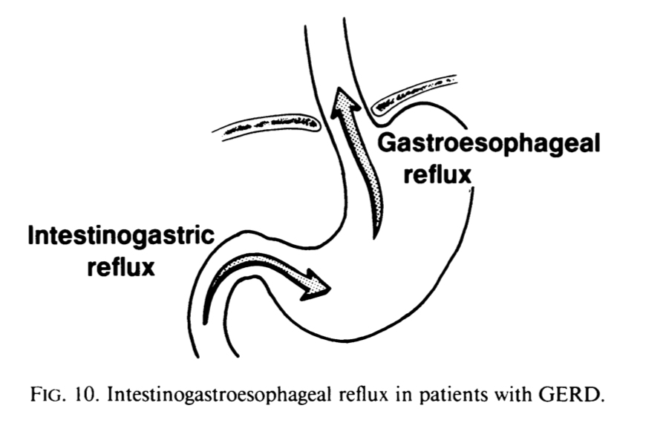
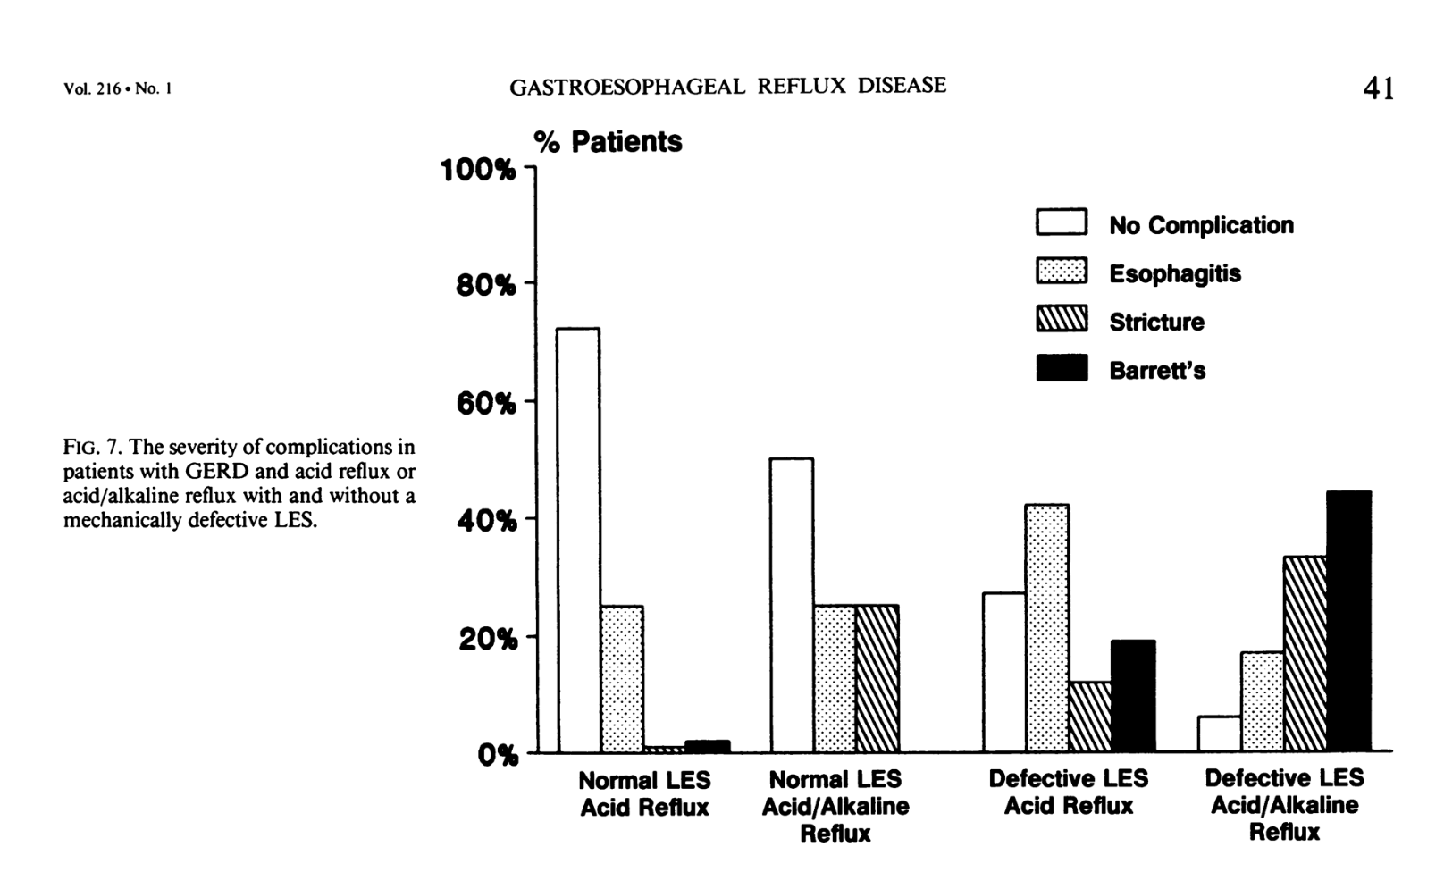
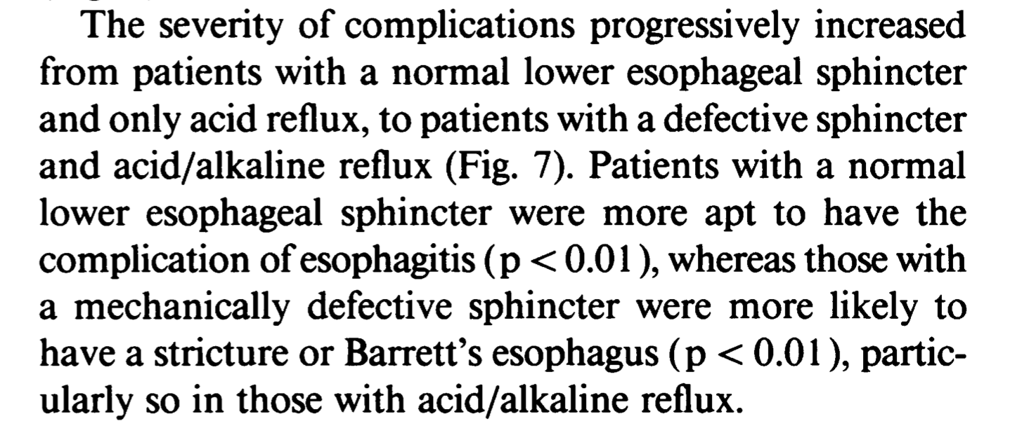
n = 205 with GERD, n = 50 healthy volunteers

Slide 11
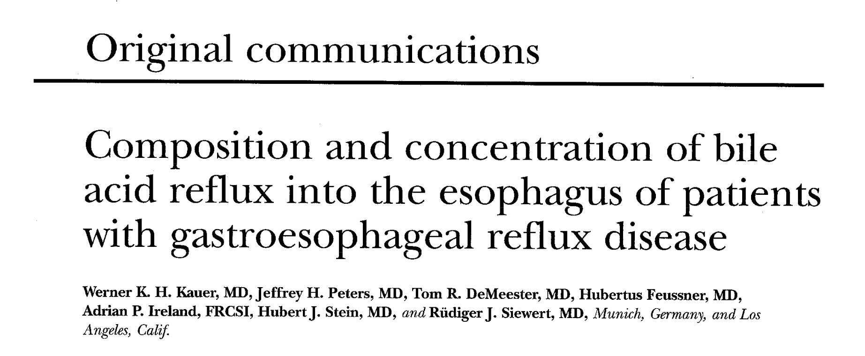
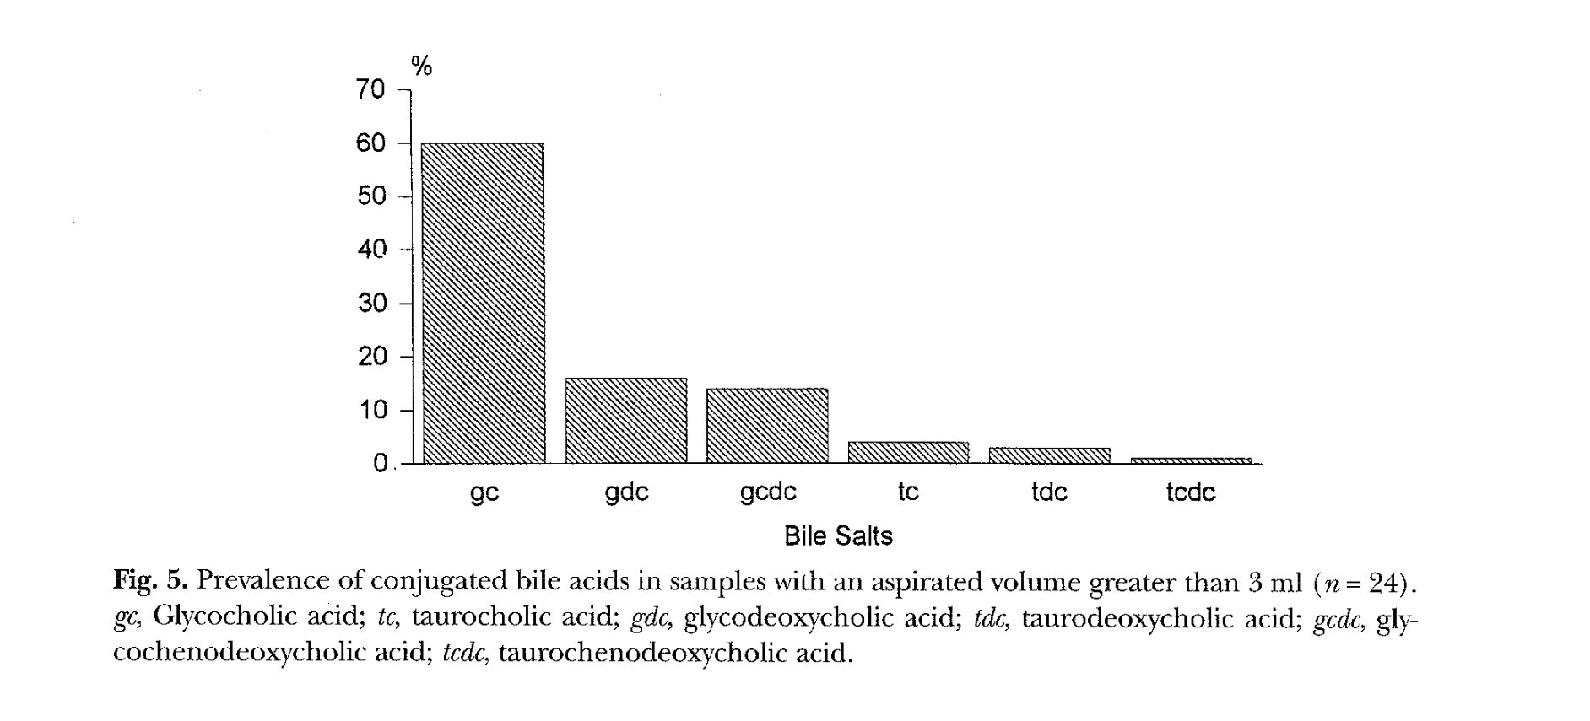
Bile acids could be detected in 58 % of normal subjects (n = 43) and 86% of patients (n = 37) (p < 0.003).
Glycin conjugated

Slide 12
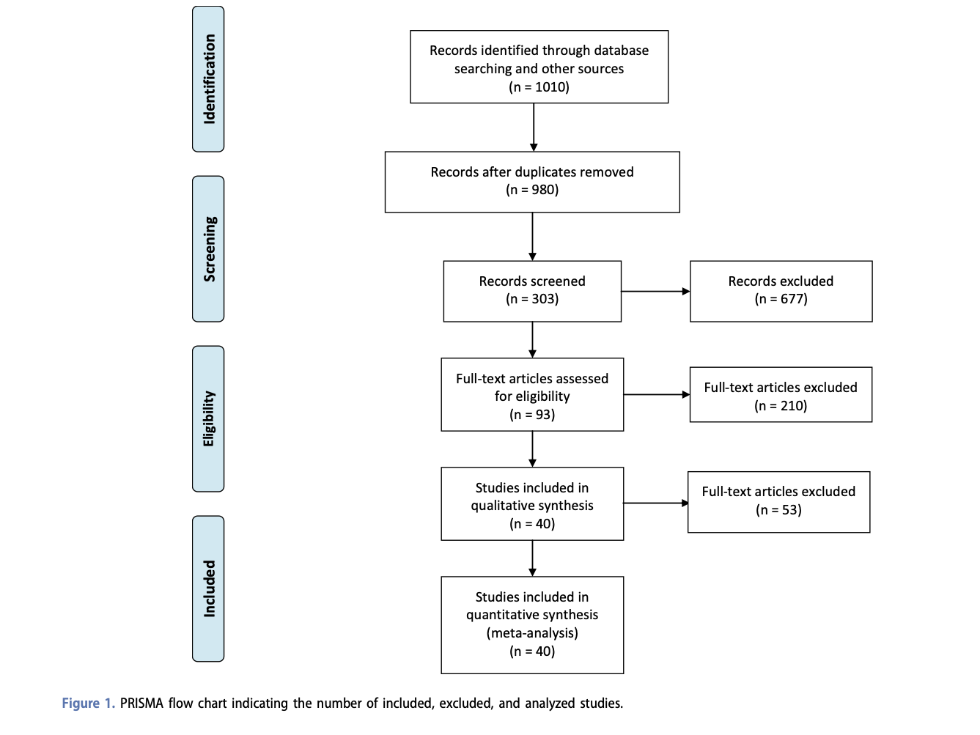
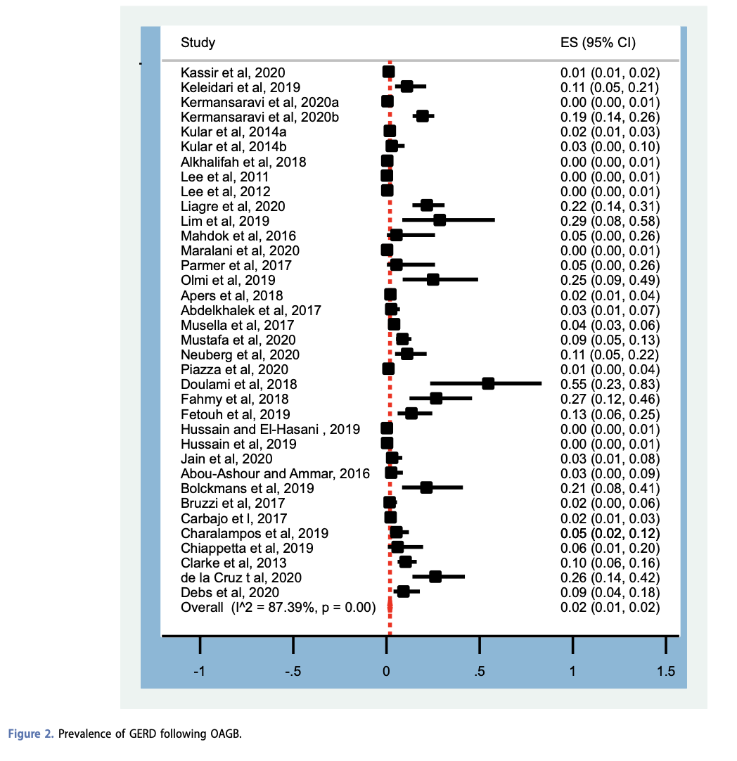
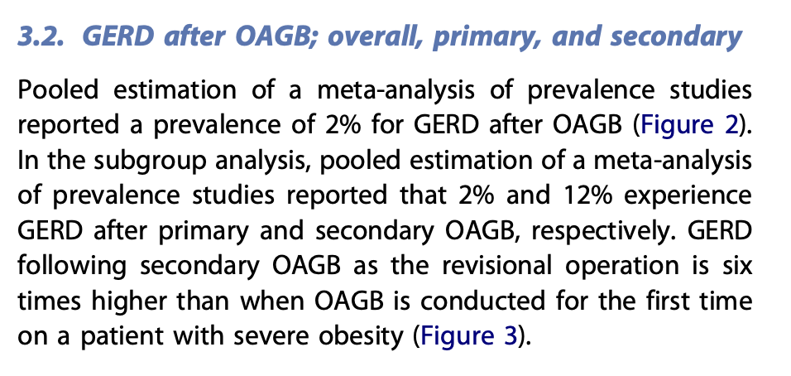

Slide 13
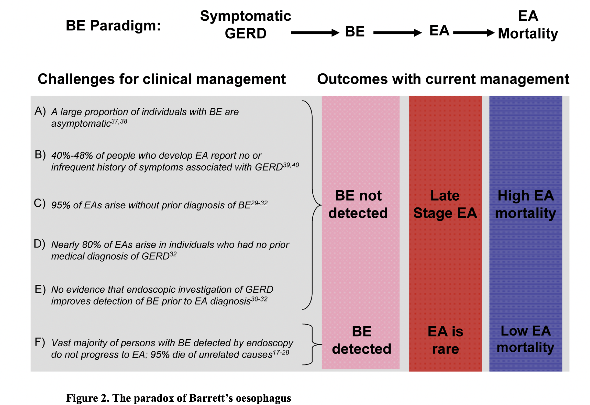
Notes:
Epidemological studies have identified 3 major risk factos – key driving forces for this cancer

Slide 14
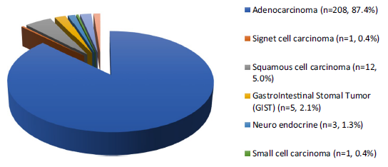
The study analyzed 324 cases of esophageal and stomach cancer after bariatric surgery.
A mean time of 5.25 years between surgery and cancer diagnosis
Only 7 cases of cancer are reported after OAGB.
Notes:
La Tabella 2 mostra una descrizione dettagliata dei tipi di chirurgia bariatrica e delle sedi anatomiche dei tumori.
Tra i pazienti inclusi, la maggior parte aveva un RYGB come procedura chirurgica bariatrica, seguita da GB e sleeve (rispettivamente, 133 (41,0%) RYGB, 97 (30,0%)GB e 58 (18,0%) SG).
Sono stati riportati 7 casi dopo OAGB-MGB (3 nel residuo gastrico, 4 nell'esofago/gastric pouch)
Nello studio di Bevilacqua et al,è stato riportato che in un paziente, il tumore è stato trovato durante la procedura chirurgica bariatrica (bendaggio gastrico laparoscopico).

Slide 15
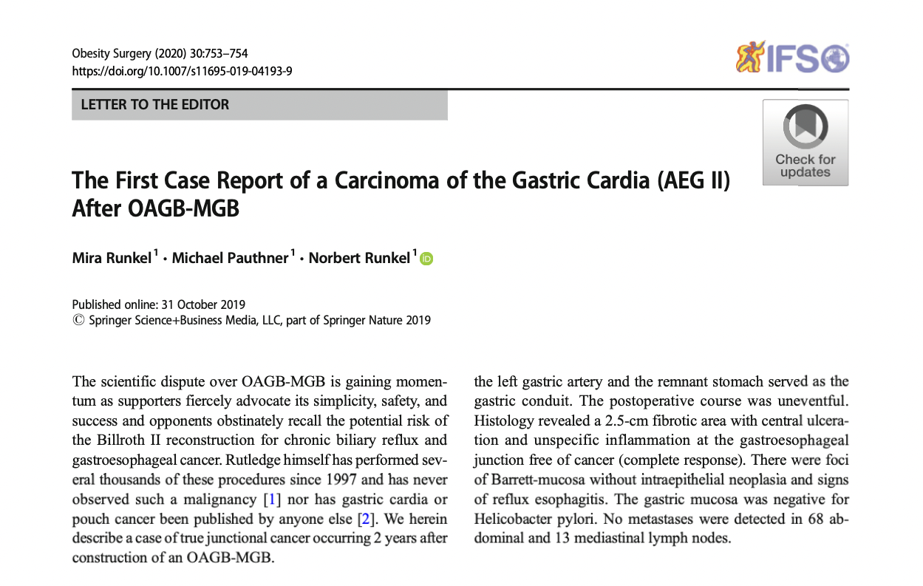
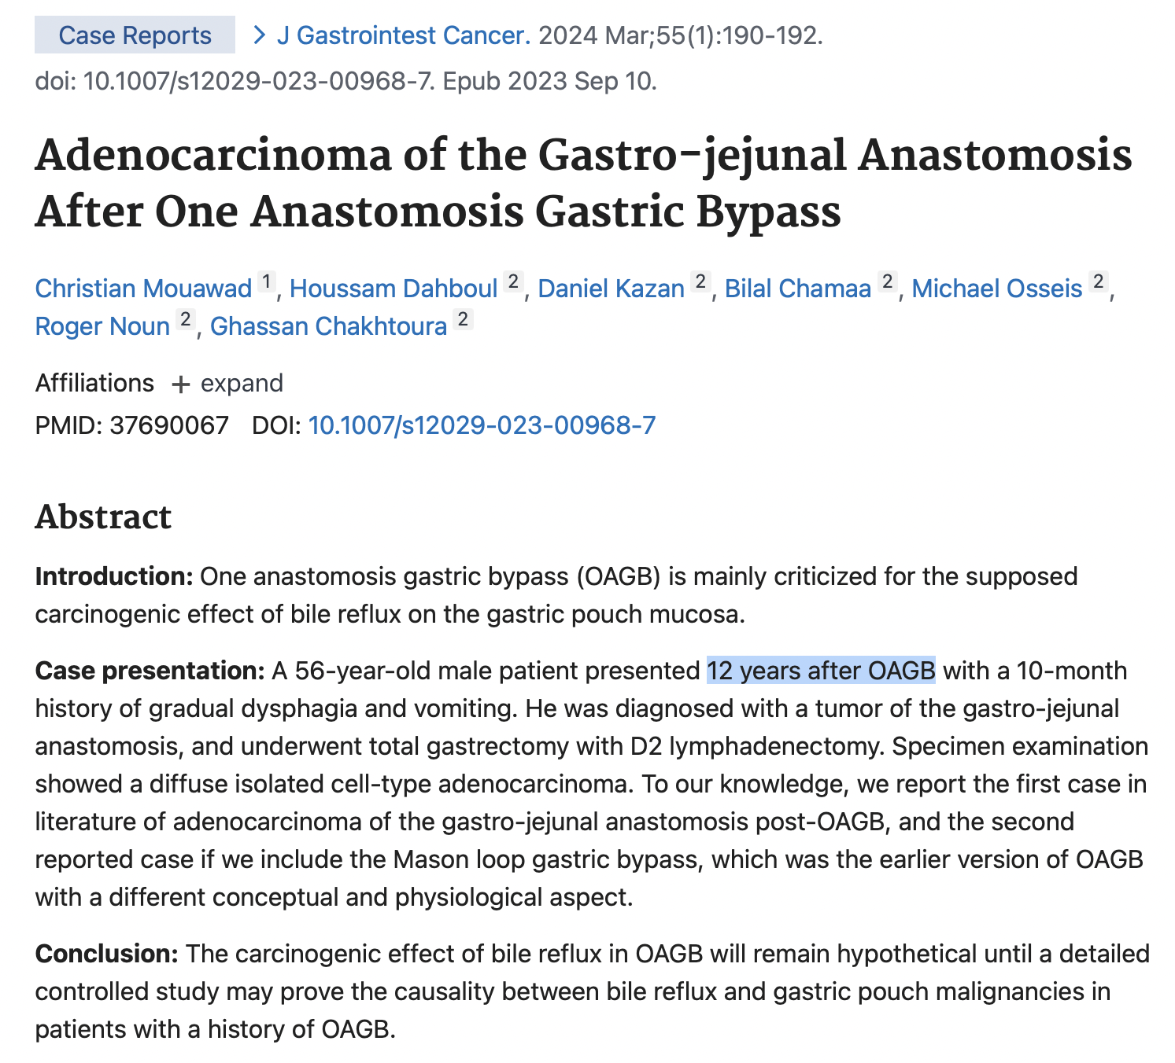
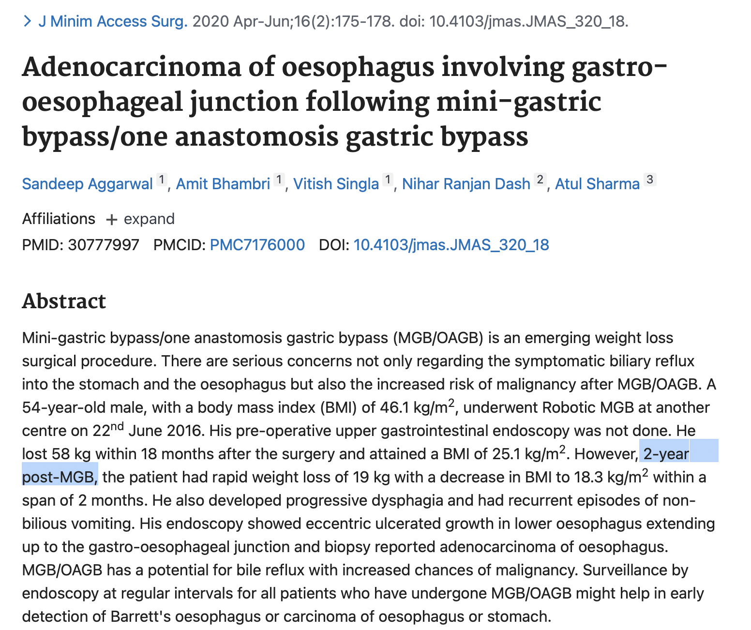

Slide 16
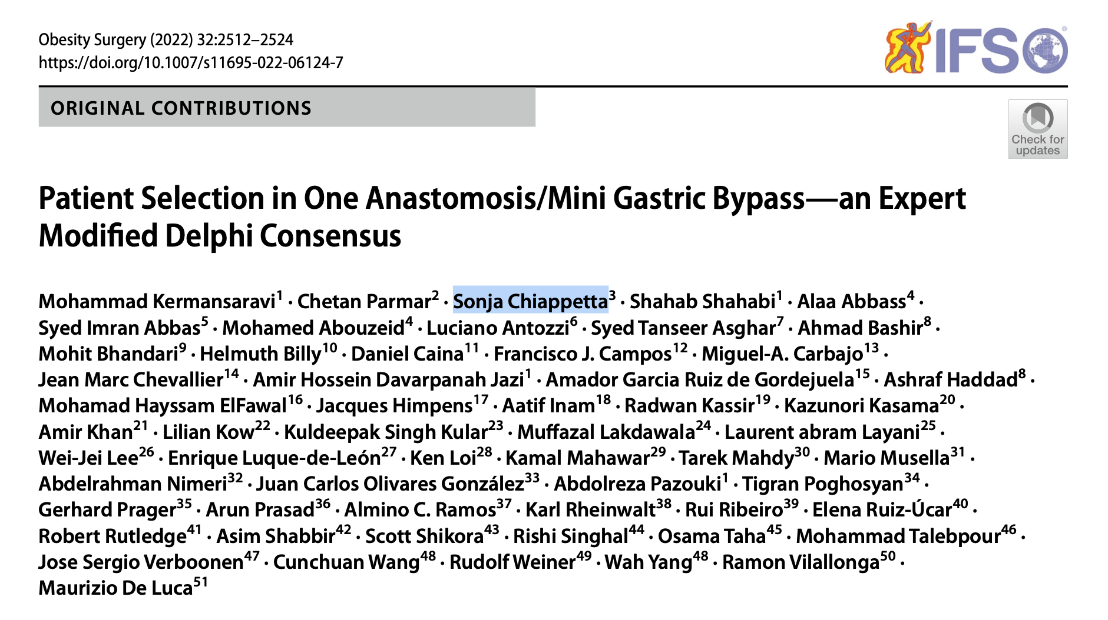

Slide 17
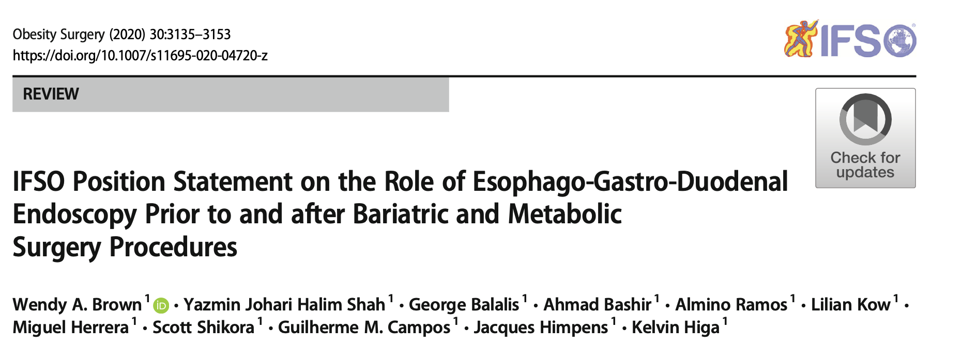
Notes:
Vor über 2000 Jahren hat

Slide 18
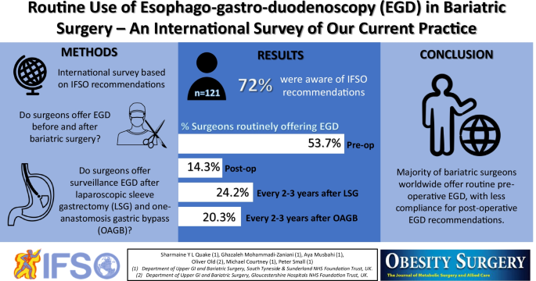
IFSO Risk Management and Prevention
frequent upper gastrointestinal endoscopies post-bariatric surgery, starting after 1 year.
followed by subsequent ones every 2–3 years
Regular monitoring and early treatment of alarming symptoms are crucial.

Slide 19
Recommendations:
Promote a healthy lifestyle
Patient Selection
Stress on regular endoscopic monitoring to detect cancer early.
Perform preoperative upper endoscopy with esophageal and gastric biopsy and Helicobacter pylori identification.
Emphasizes importance of long-term follow up for early detection of complications.

Slide 20
Conclusions
Metabolic and Bariatric Surgery offers significant benefits beyond weight loss, including a reduction in obesity-associated cancer risk and cancer-mortality.
Metabolic and Bariatric Surgery (GB, RYGB, SG) offers significant reduction of esophageal and gastric cancer incidence compared with patients who did not undergo bariatric surgery.
Up to date only 7 cases of cancer after OAGB a reported in the literature (Gastric pouch 2, Gastric remnant 3, GE junction 2).
Preoperative endoscopy + esophageal and gastric biopsy
Patient selection and
Postoperative endoscopic surveillance are necessary to reduce the risk of gastroesophageal cancer.

Slide 21
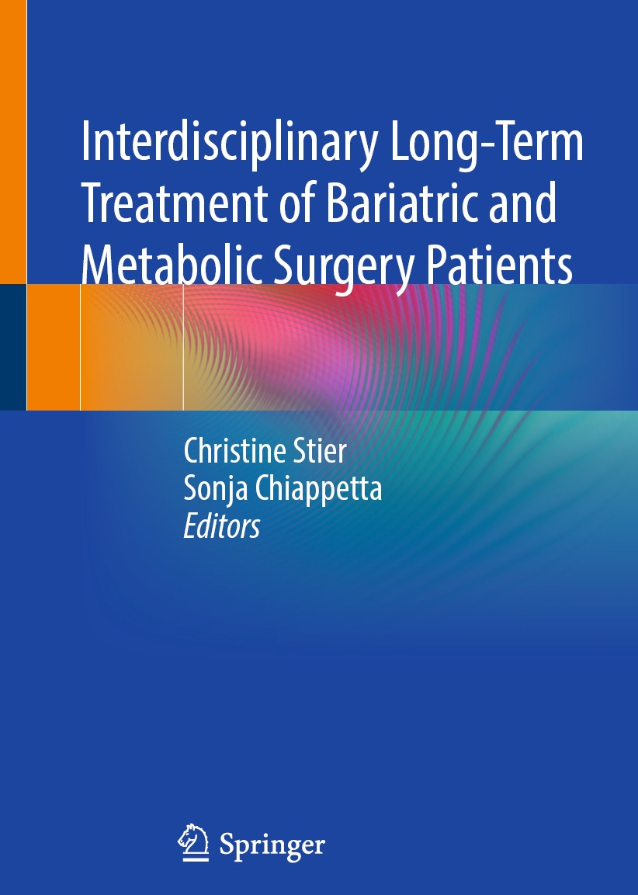
Grazie
drschiappetta@gmail.com
chiappetta.obesity.intouch
Sonja Chiappetta
PD Sonja Chiappetta

